Slide 1
Risk and Return

Slide 2
OUTLINE
Risk and Return of a Single Asset
Risk and Return of a Portfolio
Measurement of Market Risk
Relationship between Risk and Return

Slide 3
Past Returns:
Holding Period Return = Dividend + (Price at the End – Price at the beginning)
Price at the beginning
Annualised Return = Holding Period Return X 12 months
Holding period in months

Slide 4
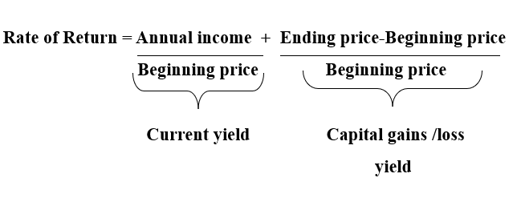
RISK AND RETURN OF A SINGLE ASSET

Slide 5
Example
Consider the following information for an equity stock
Price at the beginning of the year : Rs. 60
Dividend paid at the end of the year : Rs. 2.40
Price at the end of the year : Rs. 69
Calculate the total return on this stock
Soln : =(2.40/60 + (69-60)/60) *100 = 19%

Slide 6
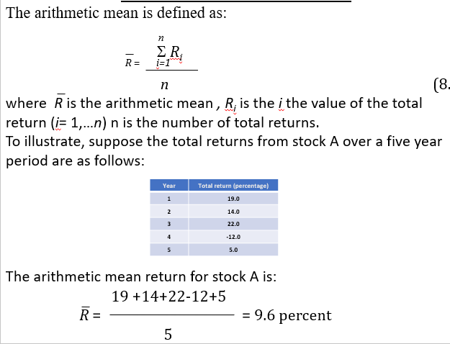
AVERAGE ANNUAL RETURNS

Slide 7
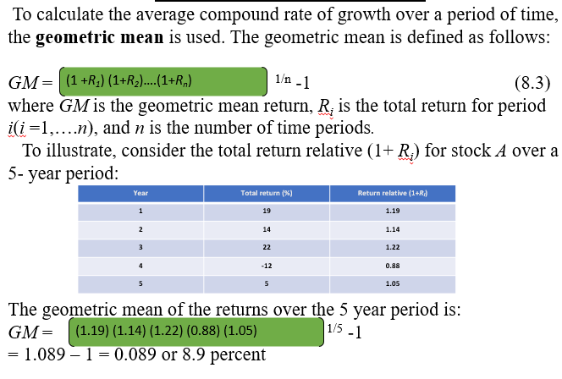
AVERAGE ANNUAL RETURNS

Slide 8
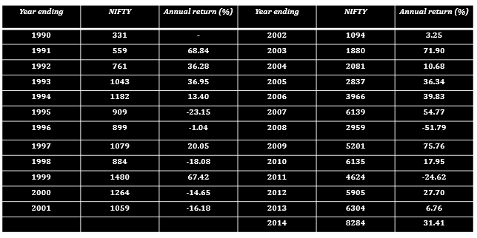
Data on the Nifty Index

Slide 9
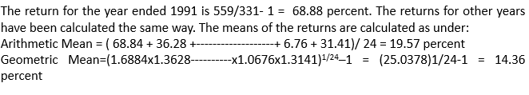
Data on the Nifty Index

Slide 10
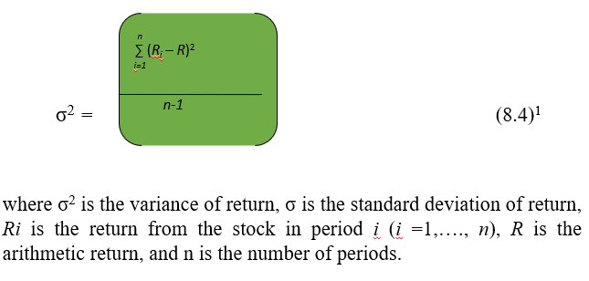
VARIANCE OF RETURNS

Slide 11
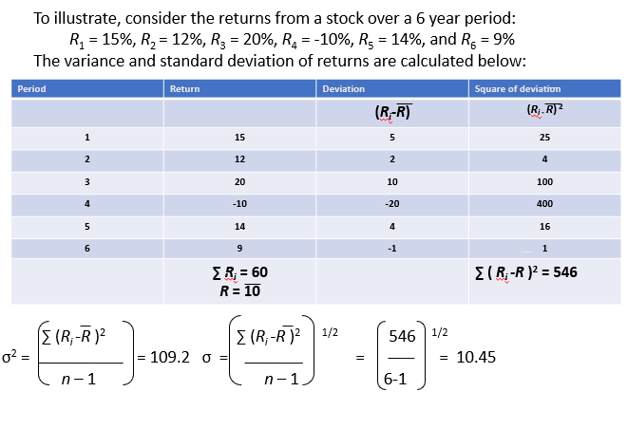
VARIANCE OF RETURNS

Slide 12
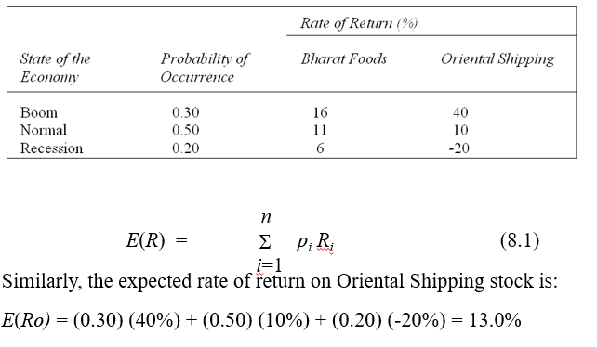
PROBABILITY DISTRIBUTION AND EXPECTED RATE OF RETURN

Slide 13
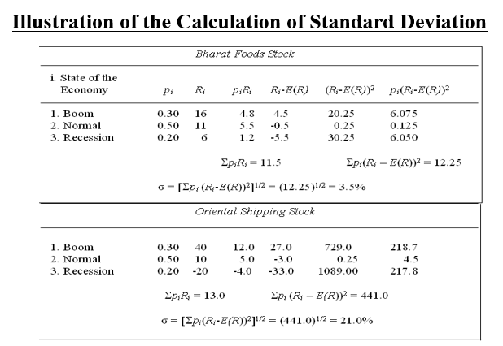
STANDARD DEVIATION

Slide 14
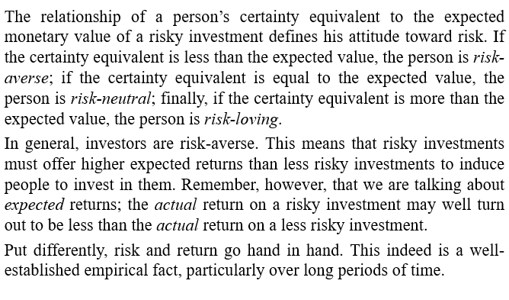
RISK AVERSION AND REQUIRED RETURNS

Slide 15
EXPECTED RETURN ON A PORTFOLIO
The expected return on a portfolio is simply the weighted average of the expected returns on the assets comprising the portfolio. For example, when a portfolio consists of two securities, its expected return is:
E(Rp) = w1 E(R1) + (1-w1) E(R2)
Where E(Rp) = Expected return on a portfolio,
E(R1) = expected return on a security 1
(1-w1) = the proportion of portfolio invested in security 2
E(R2) = expected return on a security 2

Slide 16
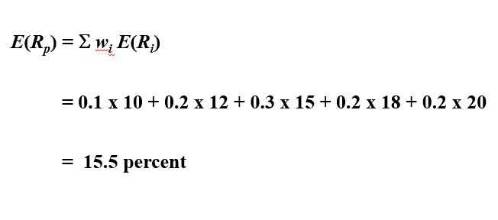
EXPECTED RETURN ON A PORTFOLIO
Illustration – consider a portfolio consisting of five securities with the following expected returns
E(R1) = 10%, E(R2) = 12%, E(R3) = 15%, E(R4) =18%, E(R5) = 20%. The portfolio proportions invested in these securities are w1 = 0.1, w2 = 0.2, w3= 0.3, w4 = 0.2, w5 = 0.2. What is the expected return on portfolio?

Slide 17
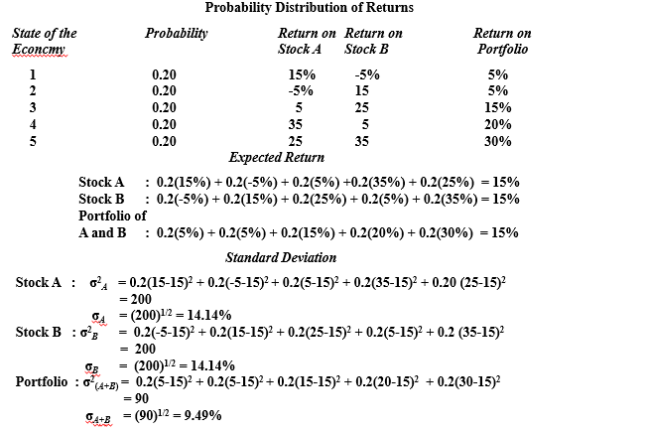
DIVERSIFICATION AND PORTFOLIO RISK

Slide 18
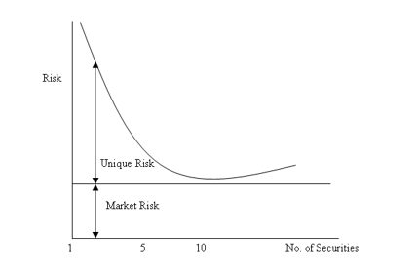
RELATIONSHIP BETWEEN DIVERSIFICATION AND RISK

Slide 19
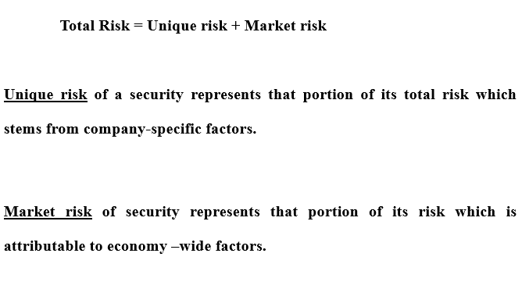
MARKET RISK VS UNIQUE RISK

Slide 20
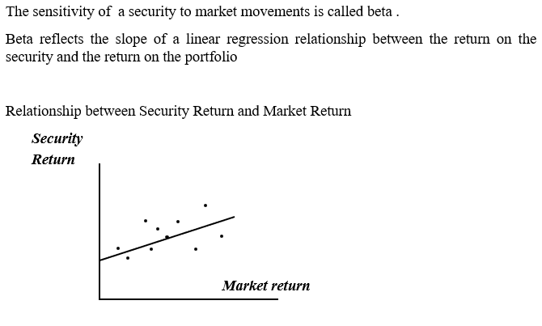
MEASUREMENT OF MARKET RISK

Slide 21
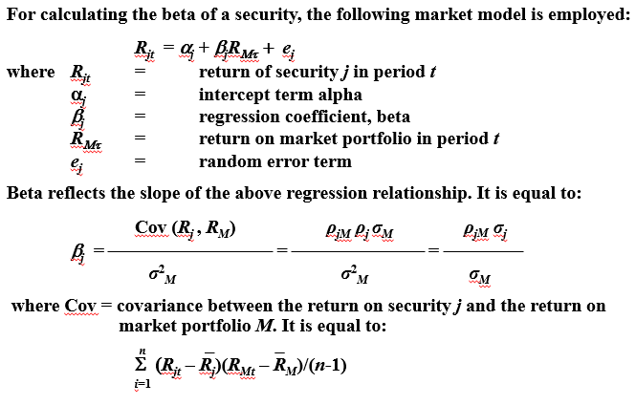
CALCULATION OF BETA

Slide 22
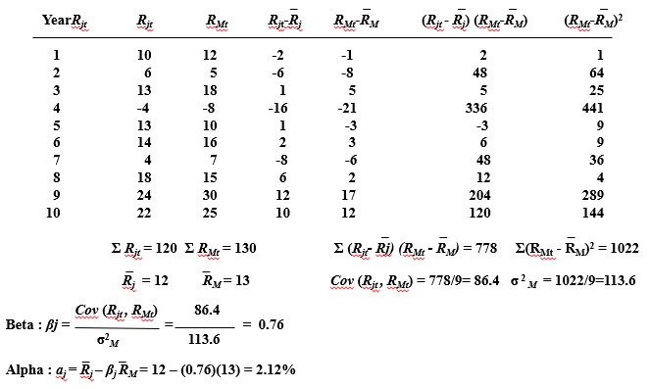
CALCULATION OF BETA Historical Market Data _ _ _

Slide 23
RECAPITULATION OF THE STORY SO FAR
Securities are risky because their returns are variable.
• The most commonly used measure of risk or variability in
finance is standard deviation.
• The risk of a security can be split into two parts: unique risk
and market risk.
• Unique risk stems from firm-specific factors, whereas market
risk emanates from economy-wide factors.
• Portfolio diversification washes away unique risk, but not
market risk. Hence, the risk of a fully diversified portfolio is its
market risk.
• The contribution of a security to the risk of a fully diversified
portfolio is measured by its beta, which reflects its sensitivity to
the general market movements.

Slide 24
IMPLICATIONS
Diversification is important. Owning a portfolio dominated by a small number of stocks is a risky proposition.
While diversification is desirable , an excess of it is not. There is hardly any gain in extending diversification beyond 10 to 12 stocks.
The performance of well –diversified portfolio more or less mirrors the performance of the market as a whole.
In a well ordered market, investors are compensated primarily for bearing market risk, but not unique risk. To earn a higher expected rate on return, one has to bear a higher degree of market risk.

Slide 25
SUMMARY
Risk is present in virtually every decision. Assessing risk and
incorporating the same in the final decision is an integral part of
financial analysis.
The rate of return on an asset for a given period (usually a period of
one year) is defined as follows:
Annual income + (Ending price – Beginning price)
Rate of return =
Beginning price
Based on the probability distribution of the rate of return, two key
parameters may be computed: expected rate of return and standard
deviation.
The expected rate of return is the weighted average of all possible
returns multiplied by their respective probabilities. In symbols,
E(R) = Σ p_{i} R_{i}

Slide 26
SUMMARY
Risk refers to the dispersion of a variable. It is commonly measured
by the variance or the standard deviation.
The variance of a probability distribution is the sum of the squares
of the deviations of actual returns from the expected return,
weighted by the associated probabilities. In symbols,
σ² = Σ p_{i} (R_{i} – R)²
Standard deviation is the square root of variance.
The expected return on a portfolio is simply the weighted average of
the expected returns on the assets comprising the portfolio. In
general, when the portfolio consists of n securities, its expected
return is:
E(R_{p)} = Σw_{i} E(R_{i})
If returns on securities do not move in perfect lockstep,
diversification reduces risk.

Slide 27
SUMMARY
As more and more securities are added to a portfolio, its risk
decreases, but at a decreasing rate. The bulk of the benefit of
diversification is achieved by forming a portfolio of about 10
securities.
The following relationship represents a basic insight of modern
portfolio theory:
Total risk = Unique risk + Market risk
The unique risk of a security represents that portion of its total risk
which stems from firm-specific factors. It can be washed away by
combining it with other securities. Hence, unique risk is also referred
to as diversifiable risk or unsystematic risk.
The market risk of a security represents that portion of its risk
which is attributable to economy-wide factors. It is also referred to as
systematic risk (as it affects all securities) or non-diversifiable risk
(as it cannot be diversified away).
The market risk of a security reflects its sensitivity to market
movements. It is called beta.

